Slide 1
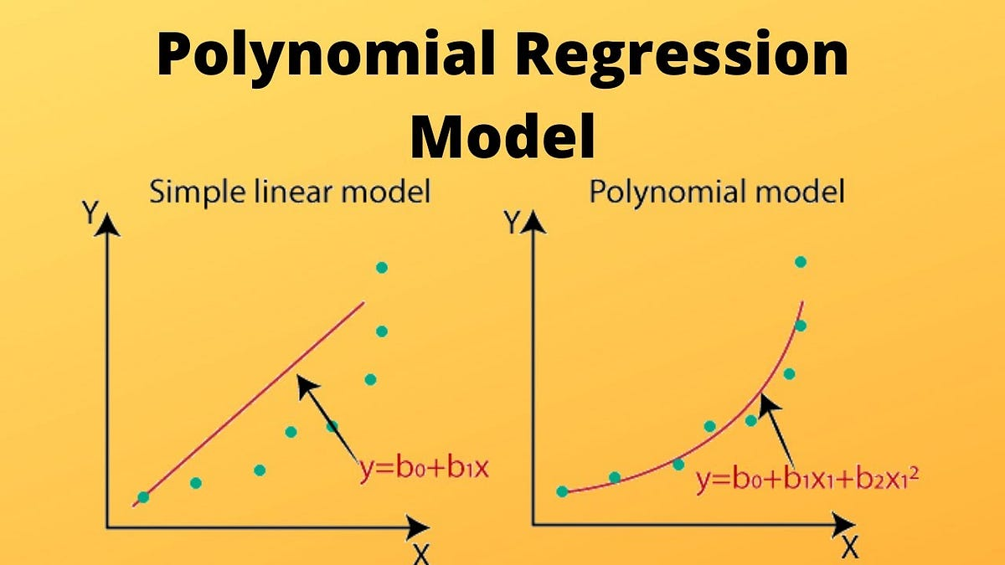

Slide 2
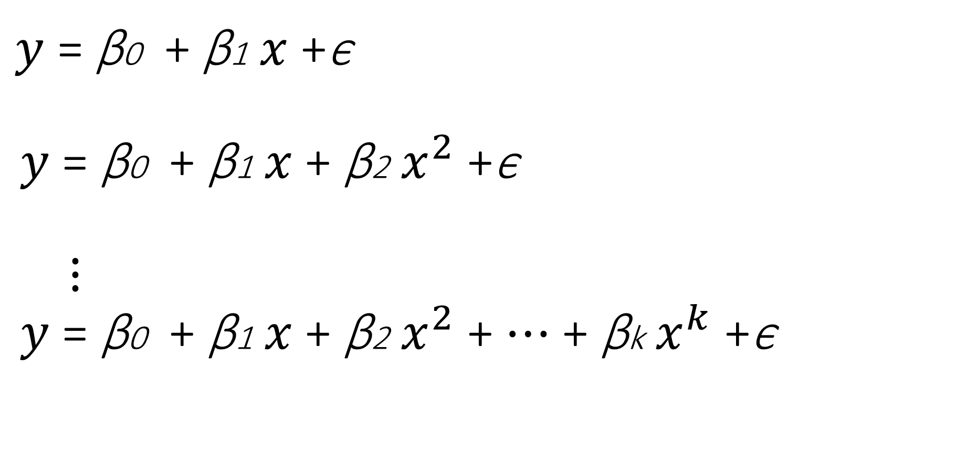
$y$ = β0 + β1 ​​$x$ +ϵ $y$ = β0 + β1 ​​$x$+ β2 $x^{2}$ +ϵ $⋮$ $y$ = β0 + β1 ​​$x$+ β2 $x^{2}$ + $⋯$ + βk $x^{k}$ +ϵ
Polynomial Regression

Slide 3
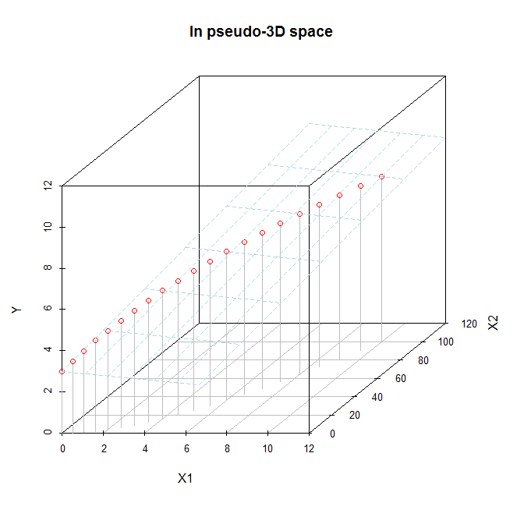

Slide 4
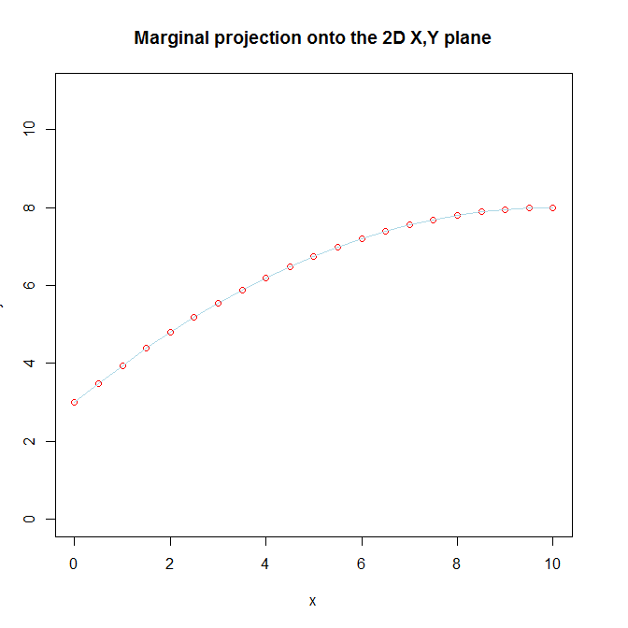

Slide 5


Slide 6
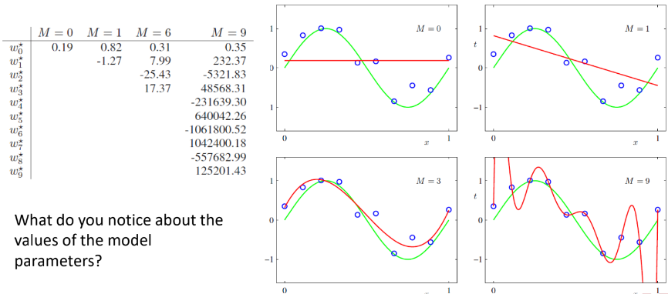

Slide 7
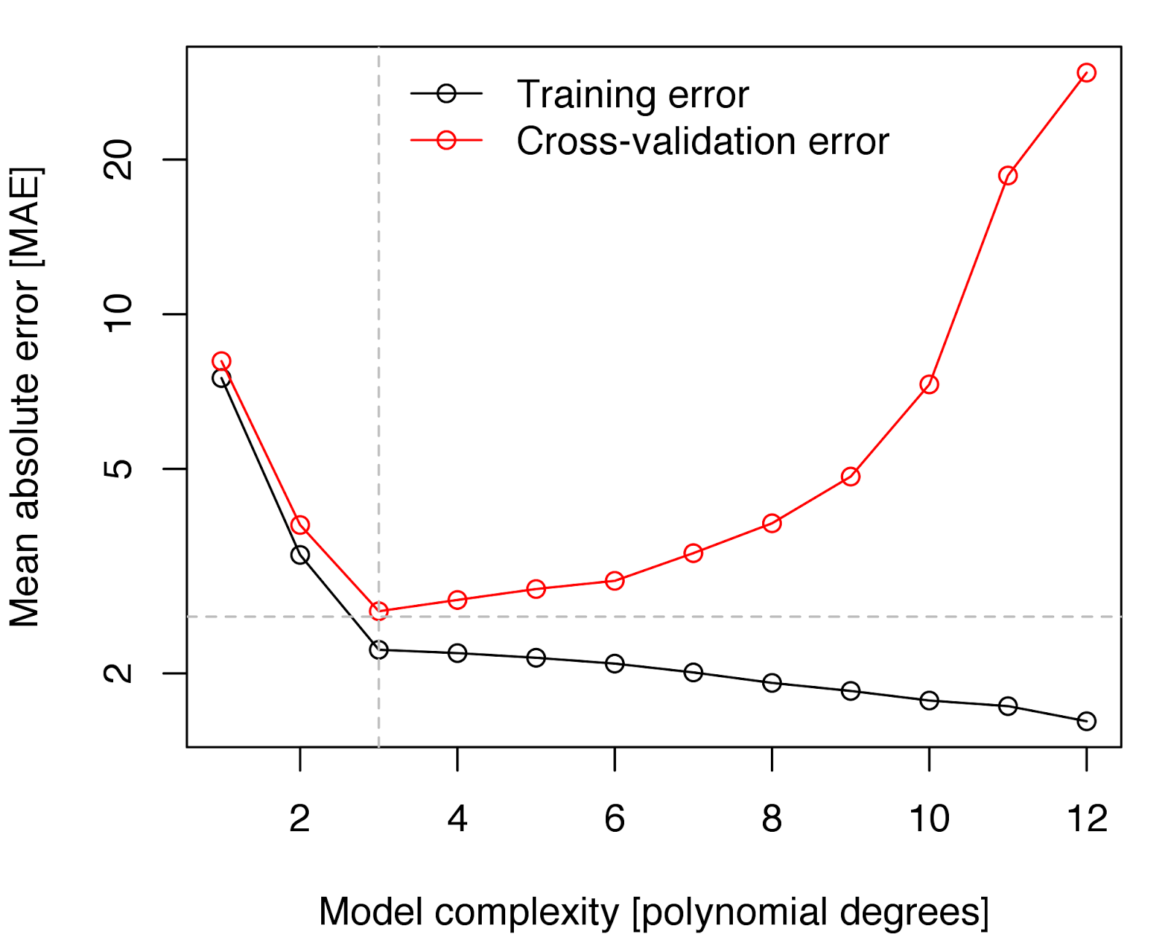

Testing error
Low variance
High bias
High variance
Low bias

Slide 8


Slide 9
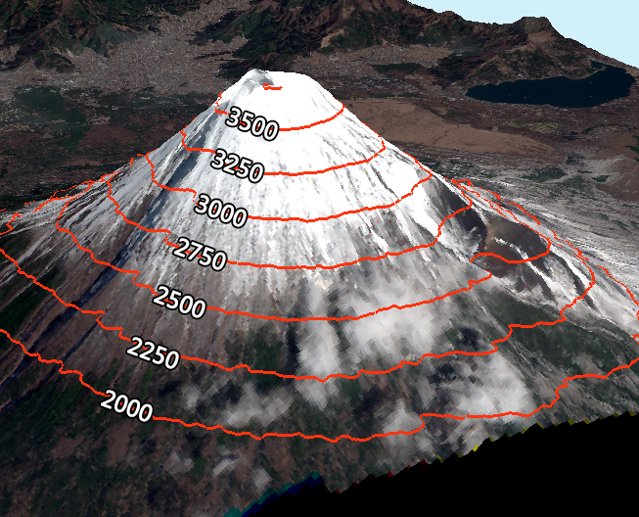
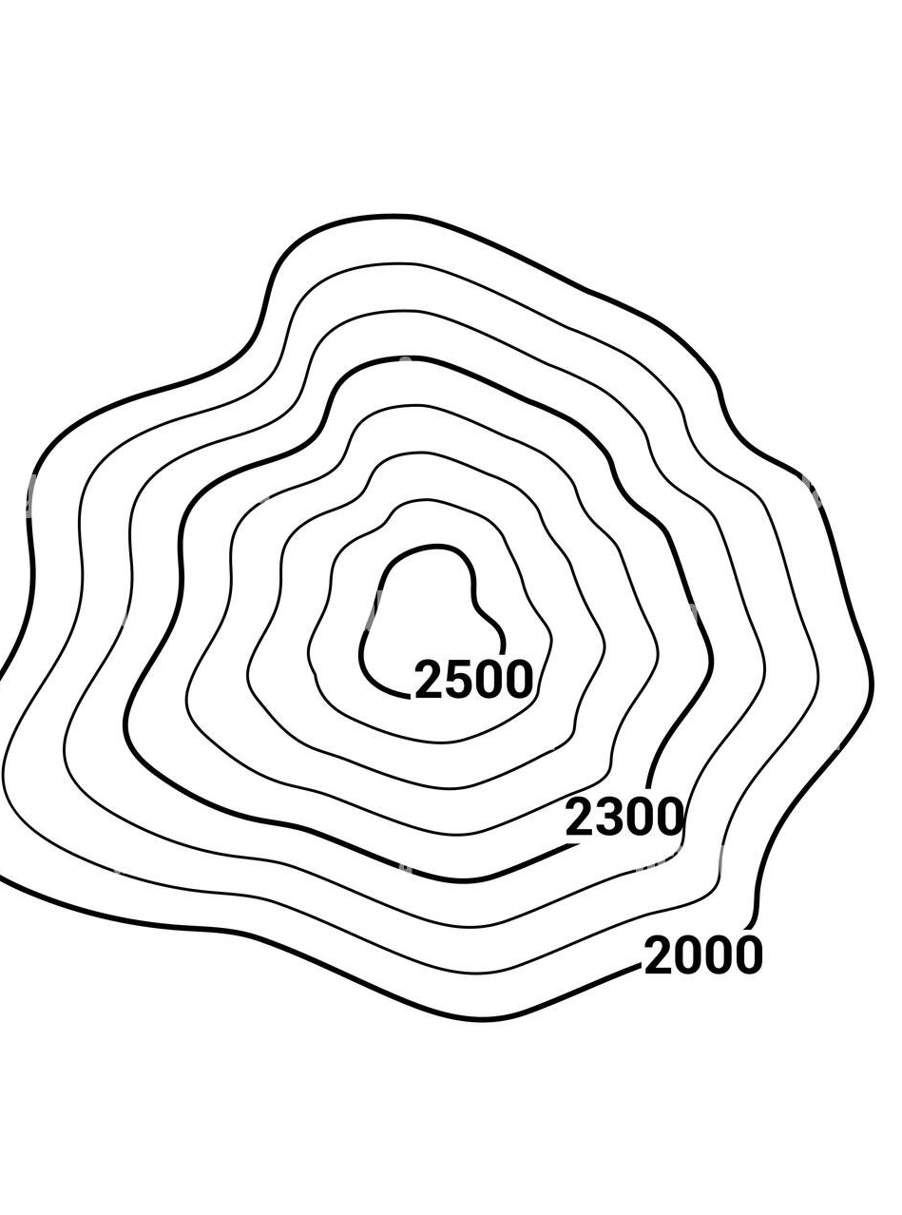

Slide 10
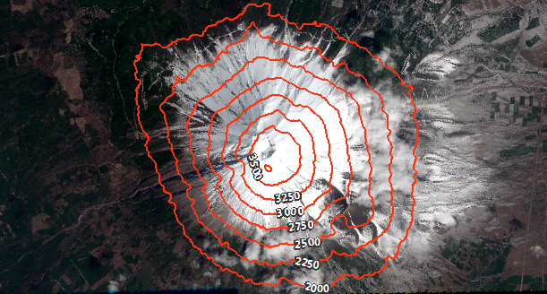

Slide 11
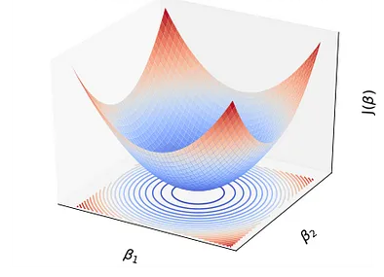
Contour plot for SSE function:

Slide 12
How can we prevent overfitting ?
- Best way is to train the model using more data, but sometimes this is difficult. - We can also reduce model complexity.
By using regularization techniques:
- Any modification we make to a learning algorithm that is intended to
reduce its generalization/test error, but not its training error.

Slide 13


Slide 14
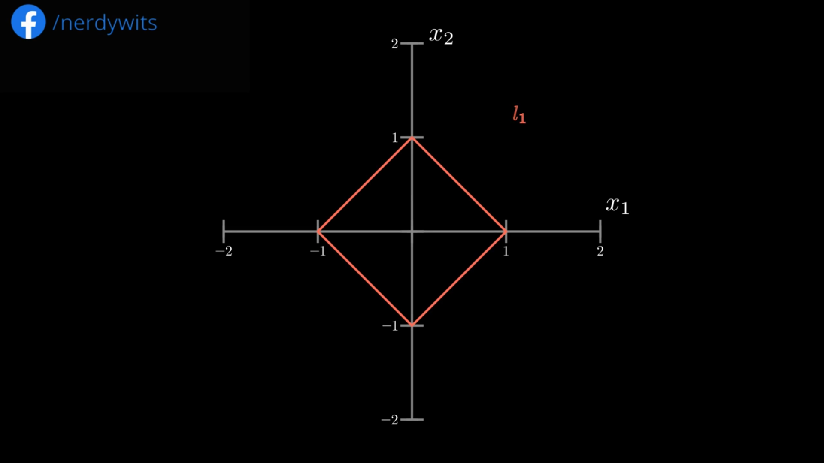
L¹ norm :

Slide 15
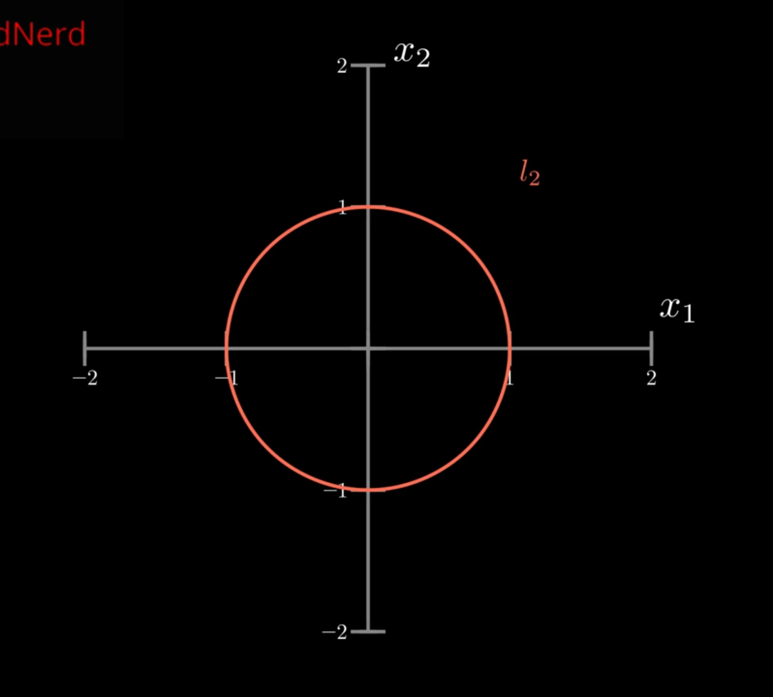

L² norm :

Slide 17
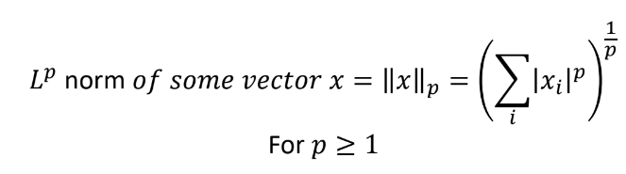
Regularization
- A possible way to avoid overfitting is to add extra terms in the objective function that can be thought as corresponding to a soft constraint on the parameter values.
- A measure the size of a vector (maps a vector to a non-negative value representing its size).
- L^{p} norm is given by :

Slide 18
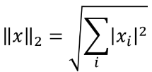
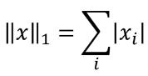
L¹ norm & L² norm
- For p=2 (L² norm ) :
- (L² norm is simply the Euclidean distance from the origin to the point identified by x)
- For p=1 (L¹ norm ) :

Slide 19
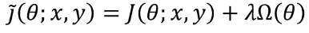
Using the norm to constrain parameter values
Basic idea: Adding a parameter norm penalty Ω(θ) to the objective function J :
- Where λ ∈ [0, ∞) is a hyper-parameter that weights the relative contribution of the norm penalty term Ω(θ)

Slide 20
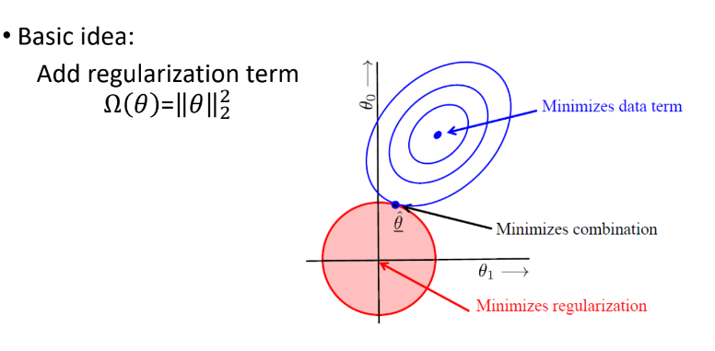
Ridge Regression

Slide 21
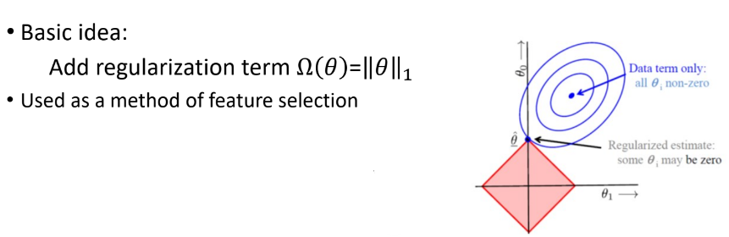
Lasso Regression

Slide 22

DO YOU REMEMBER THAT ? we know that : $\overset{⃑}{\text{ϵ}}$ = $\overset{⃑}{y}$ - $\overset{⃑}{x} \overset{⃑}{\text{β}}$ $∴ԑ^{T}ԑ$ = ${\text{(}\overset{⃑}{ y}\text{ − }\overset{⃑}{x} \overset{⃑}{\text{β}} \text{)}}^{T}$ ( $\overset{⃑}{y}$ - $\overset{⃑}{x} \overset{⃑}{\text{β}}$ ) $ԑ^{T}ԑ$ = [ $y^{T}$ - ${\text{(}\overset{⃑}{x} \overset{⃑}{\text{β}}\text{ ) }}^{T}$ ] * ( $\overset{⃑}{y}$ - $\overset{⃑}{x} \overset{⃑}{\text{β}}$ ) $ԑ^{T}ԑ$ = [ $y^{T}$ - ${ \text{β}}^{T}$ $x^{T}$ ] * ( $\overset{⃑}{y}$ - $\overset{⃑}{x} \overset{⃑}{\text{β}}$ ) $ԑ^{T}ԑ$ = $y^{T}y$ - $y^{T}x \text{β}$ - ${ \text{β}}^{T}$ $x^{T}y$ + ${ \text{β}}^{T}$ $x^{T}x \text{β}$ $ԑ^{T}ԑ$ = $y^{T}y$ - $2$ ${ \text{β}}^{T}$ $x^{T}y$ + ${ \text{β}}^{T}$ $x^{T}x \text{β}$ (1)

Slide 23
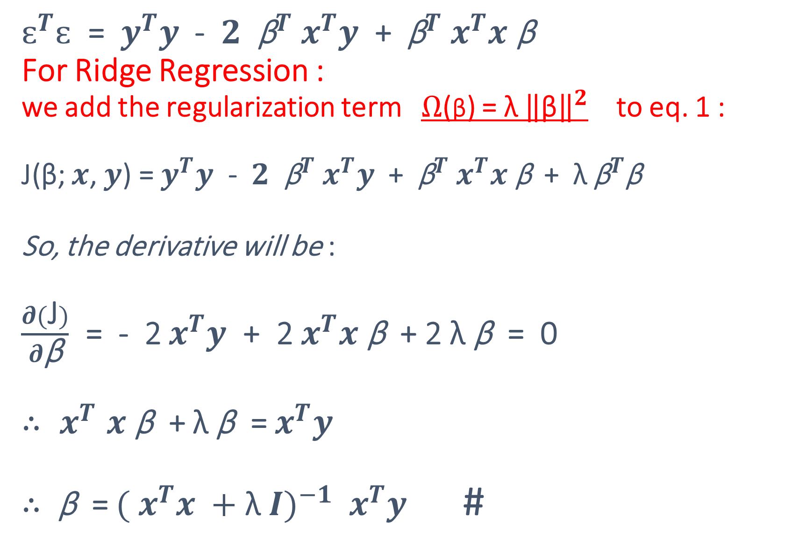
$ԑ^{T}ԑ$ = $y^{T}y$ - $2$ ${ \text{β}}^{T}$ $x^{T}y$ + ${ \text{β}}^{T}$ $x^{T}x \text{β}$ For Ridge Regression : we add the regularization term $Ω$(β) = λ ${\left\|\text{β}\right\|}^{2}$ to eq. 1 : J(β; $x$, $y$) = $y^{T}y$ - $2$ ${ \text{β}}^{T}$ $x^{T}y$ + ${ \text{β}}^{T}$ $x^{T}x \text{β}$ + λ ${\text{β}}^{T}$β So, the derivative will be : $\frac{∂(\text{J})}{∂\text{β}}$ = - 2 $x^{T}y$ + 2 $x^{T}x \text{β}$ + 2 λ β = 0 ${∴ x}^{T}x \text{β}$ + λ β = $x^{T}y$ $∴$ $\text{β}$ = ${({ x}^{T}x +\text{λ} I)}^{−1}$ $x^{T}y$ #
(1)

Slide 24
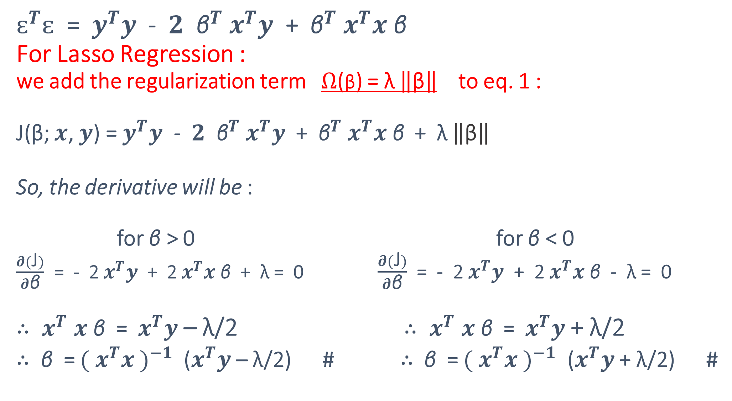
$ԑ^{T}ԑ$ = $y^{T}y$ - $2$ ${ \text{β}}^{T}$ $x^{T}y$ + ${ \text{β}}^{T}$ $x^{T}x \text{β}$ For Lasso Regression : we add the regularization term $Ω$(β) = λ $\left\|\text{β}\right\|$ to eq. 1 : J(β; $x$, $y$) = $y^{T}y$ - $2$ ${ \text{β}}^{T}$ $x^{T}y$ + ${ \text{β}}^{T}$ $x^{T}x \text{β}$ + λ $\left\|\text{β}\right\|$ So, the derivative will be : for $\text{β}$ > 0 for $\text{β}$ < 0 $\frac{∂(\text{J})}{∂\text{β}}$ = - 2 $x^{T}y$ + 2 $x^{T}x \text{β}$ + λ = 0 $\frac{∂(\text{J})}{∂\text{β}}$ = - 2 $x^{T}y$ + 2 $x^{T}x \text{β}$ - λ = 0 ${∴ x}^{T}x \text{β}$ = $x^{T}y$ – λ/2 ${∴ x}^{T}x \text{β}$ = $x^{T}y$ + λ/2 $∴$ $\text{β}$ = ${({ x}^{T}x )}^{−1}$ ($x^{T}y$ – λ/2) # $∴$ $\text{β}$ = ${({ x}^{T}x )}^{−1}$ ($x^{T}y$ + λ/2) #
(1)

Slide 25



Slide 26
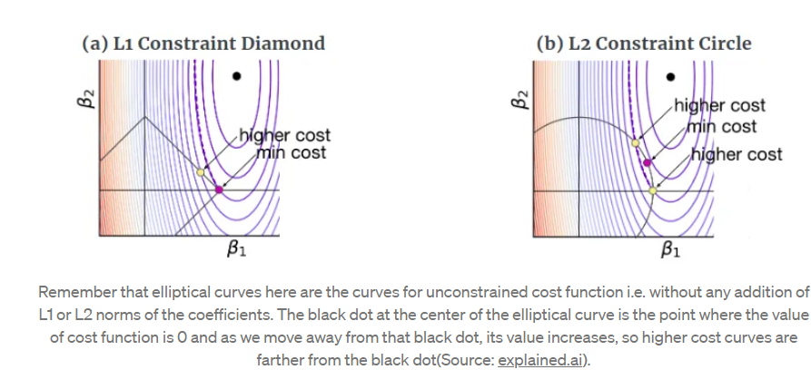

Slide 27
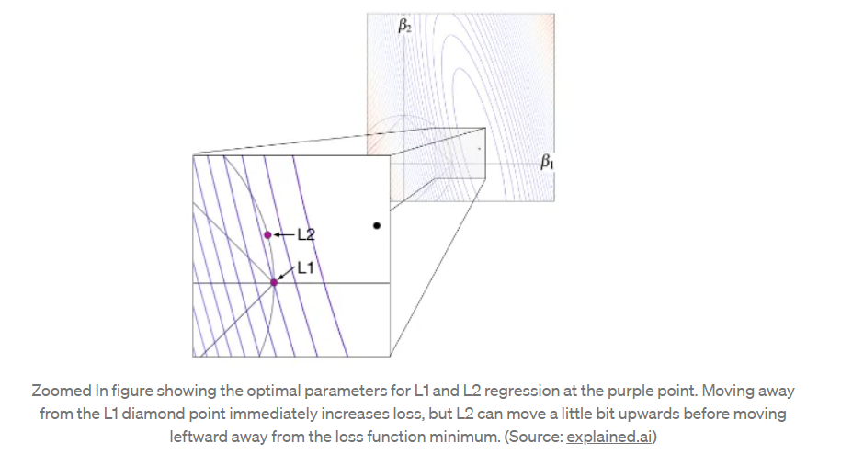

Slide 28
Conclusion
L¹ regularization, minimizes the sum of the absolute values
L² regularization minimizes the sum of squares.
Choosing L¹ or L² That depends on the specific problem
L¹ regularization has an important advantage: it tends to produce a sparse model. That is, it often sets many weights to zero, effectively declaring the corresponding attributes to be irrelevant.

Slide 29
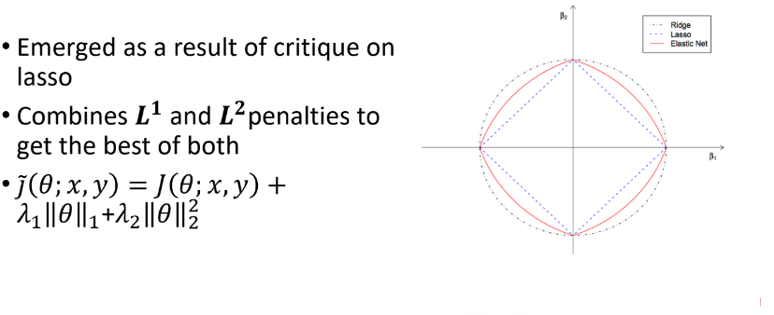
Elastic net

Slide 30


2
2
ElasticNetMSE = MSE(y,$y_{pred })+ α( \frac{1 −l1 ratio}{2}∗{\left\|Θ\right\|}^{2}+l1 ratio ∗\left\|Θ\right\| )$

